Slide 1
SQL CREATe & POPULATE tables
Here are screenshots of SQL DDL statements in Microsoft SQL Server Management Studio to create several tables, indicating the primary and foreign keys, constraints, and attribute characteristics and then inserting data into those tables

Slide 2
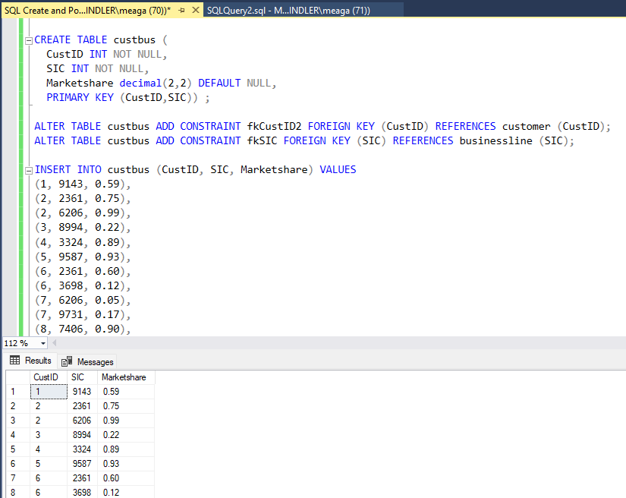
--I created the table custbus, used alter statements to add foreign key constraints, inserted values into the table (using Excel to create the syntax). The first 8 rows of output of the table show in the results window.

Slide 3
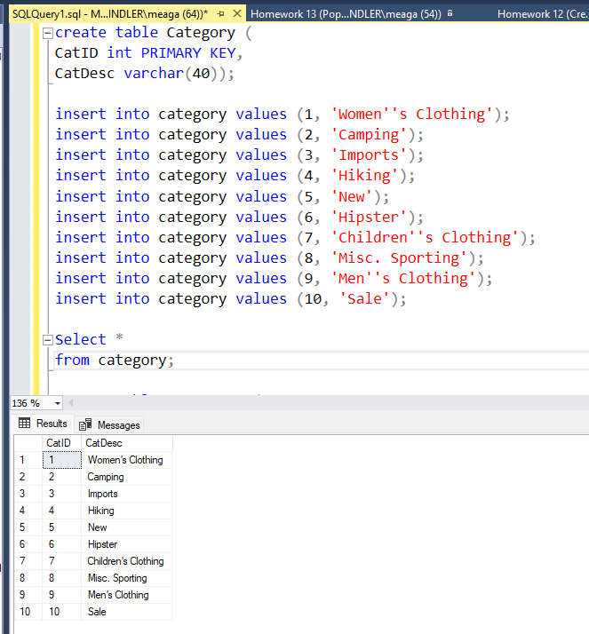
--I created the category table, indicated the primary key, inserted values into the table (using Excel to create the syntax). The output of the category table is shown in the results window.

Slide 4
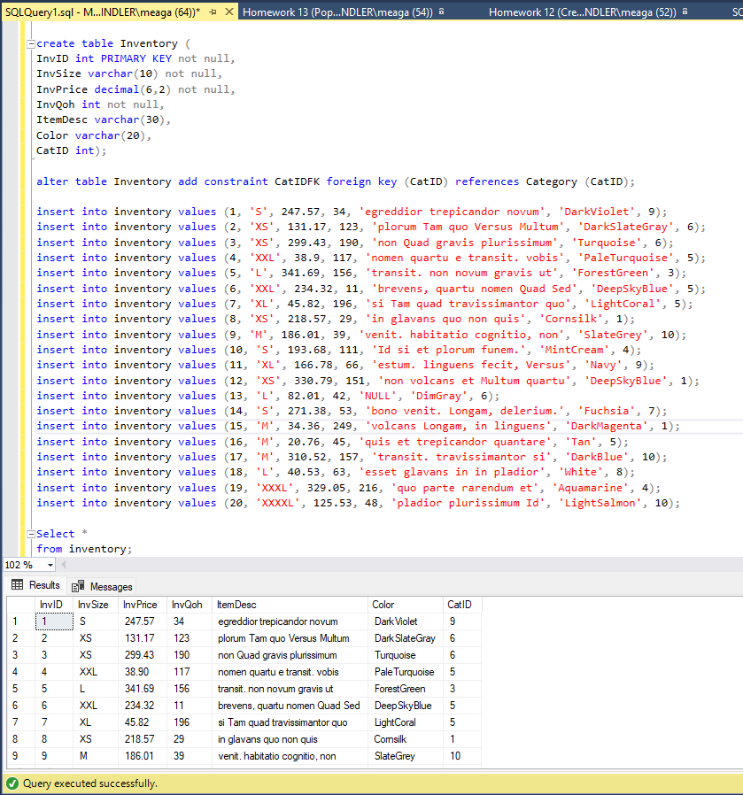
--I created the inventory table, which is a child to the category table. It includes a foreign key constraint from the category table. I inserted values into the table (using Excel to create the syntax). The output of the inventory table is shown in the results window.

